Slide 1
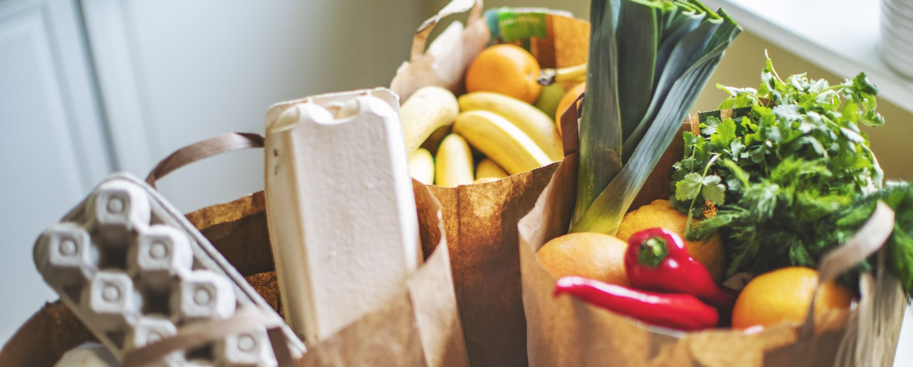
Buying food
Kupovina namernica

Slide 2
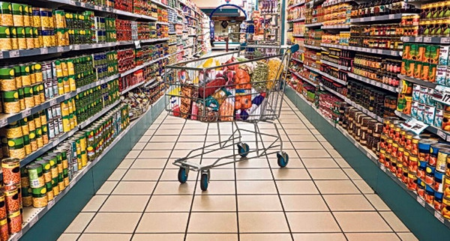
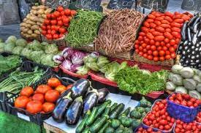
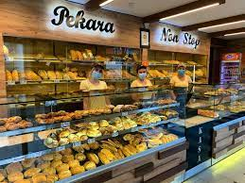
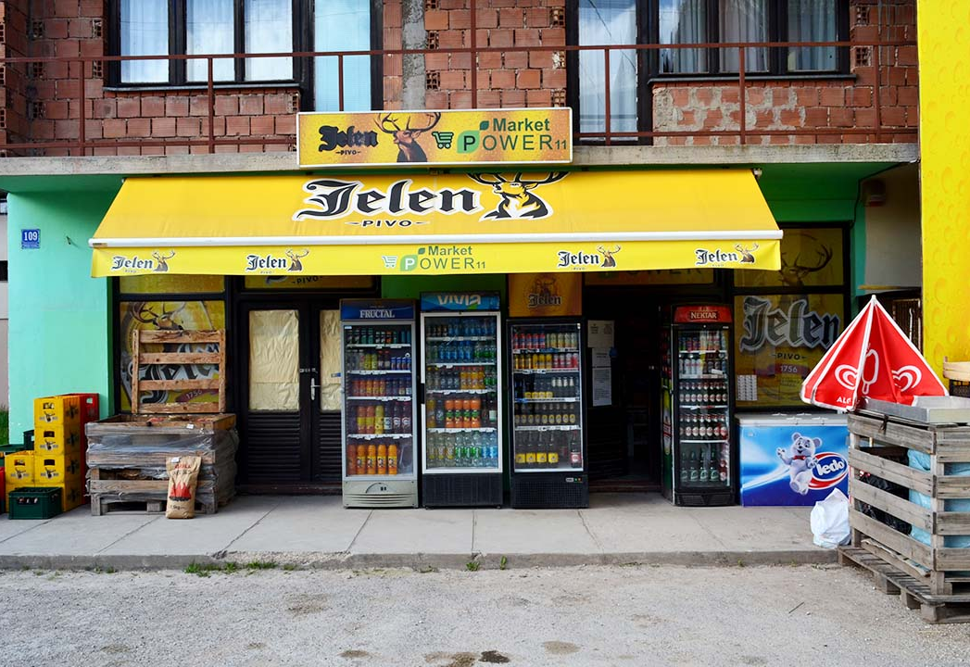
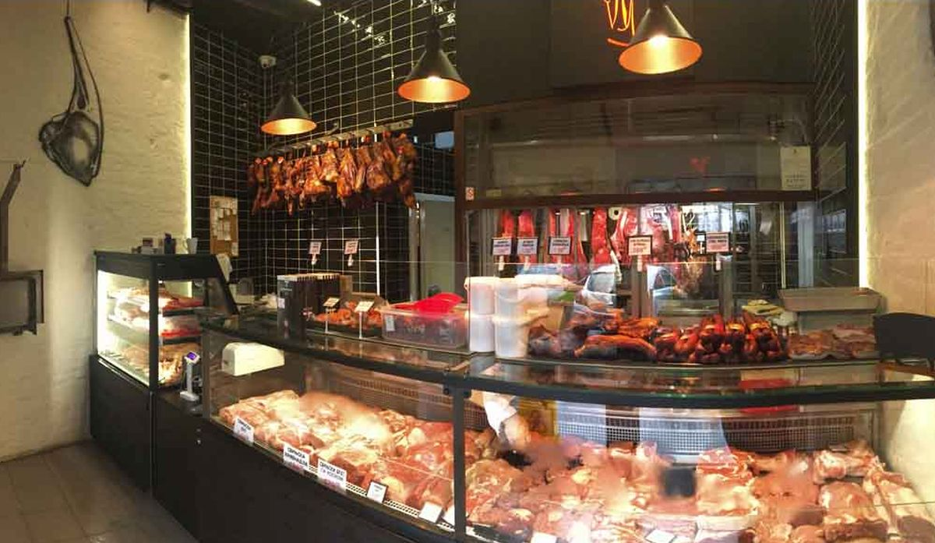
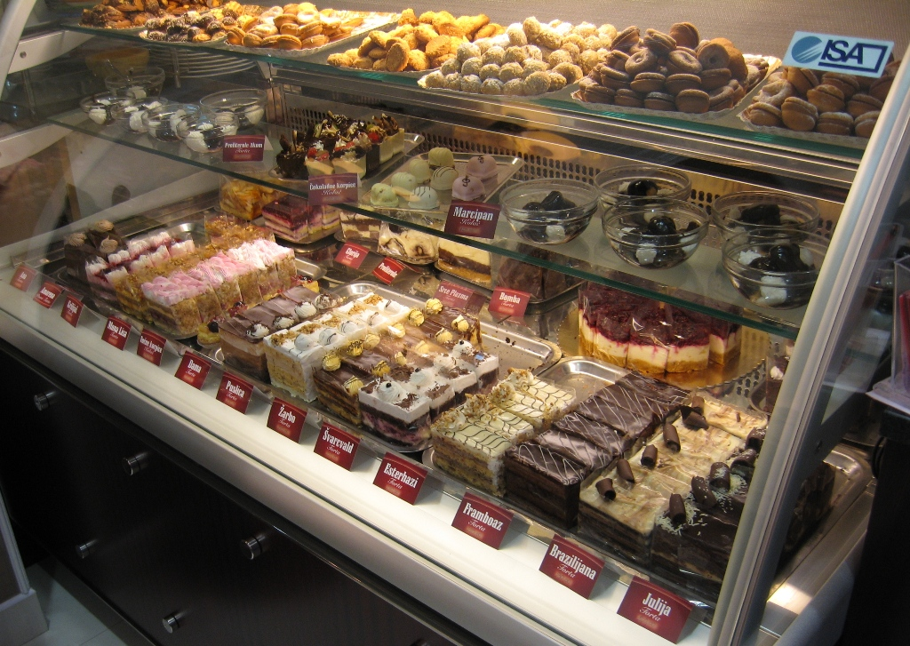
Types of stores
Pijaca
Prodavnica
Samoposluga
Mesara
Pekara
Poslastičarnica

Slide 3
Useful phrases
Express need or desire to diferent degrees. Ask if someone needs something else. Treba mi. I need. Još nešto? Želim. I want/wish. ­ Reply to question. Request something in a shop. To je sve. Dajte mi, molim vas. Ništa više. Ask how much something cost. ­ Deal with payment. Koliko košta? Sitno. (‘small money’) Express quantities of diferent items. Kusur. (change) 250 grama ­ Say that something is expensive. Pola kile To je skupo! Kilogram kilo i po

Slide 4
Dajte mi molim vas…
Kilo, kilogram brašna Pola kile mlevenog mesa Pola kile junetine Kilo i po jagnjetine 200 grama šunke Dve kile integralnog pirinča
Flaša vina - bottle of wine Čaša soka - glass of juice Šolja kafe - cup of cofee Kašika šećera - spoon of sugar

Slide 5
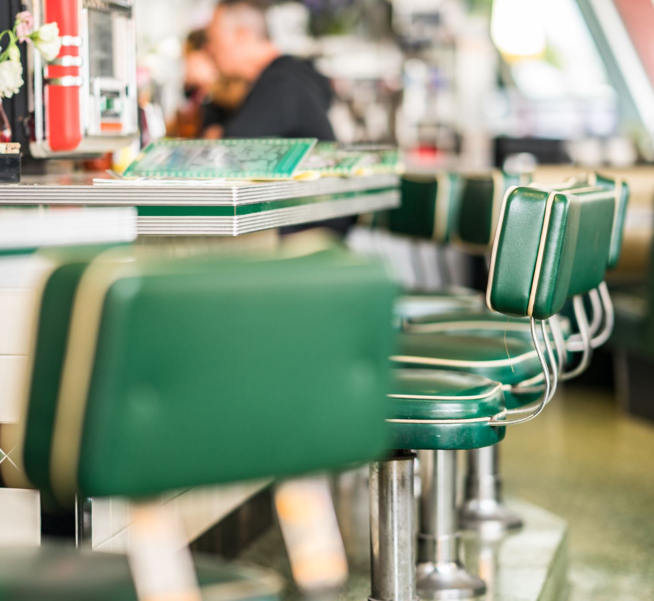
Koji je ovo recept?
Treba vam 250 grama brašna, dva jaja, šolja mleka, malo vode, kašika šećera i malo soli. Za fil vam treba džem, limun, šećer, čokolada ili orasi

Slide 6
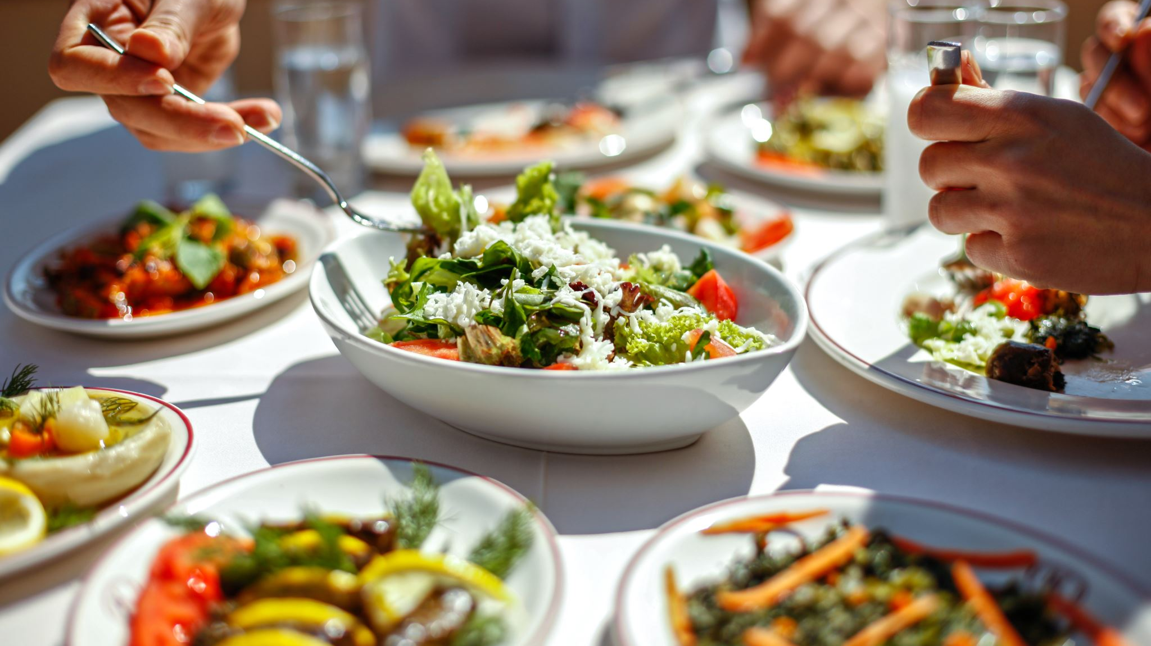
At the Restaurants

Slide 7
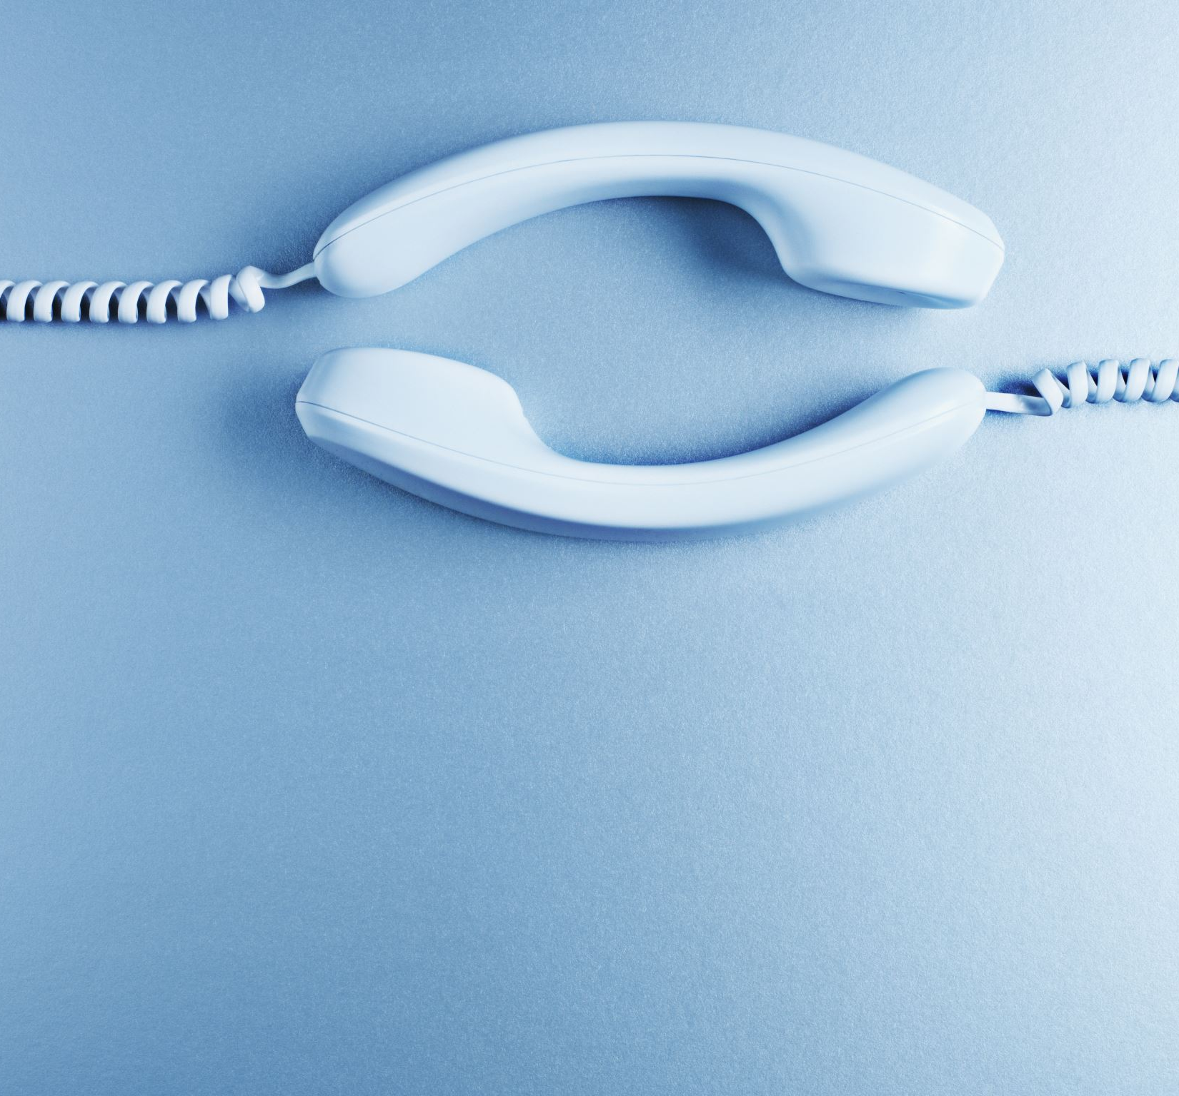
Conversation and Vocabulary

Slide 8
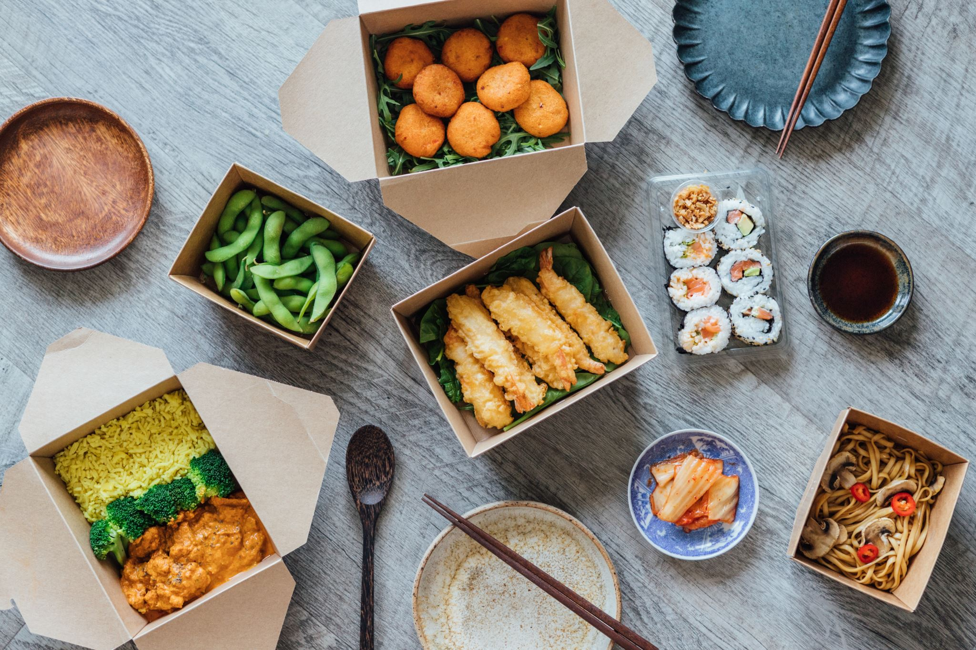
KEYPHRASES
How to: Ask for a recommendation. Šta nam preporučujete? Suggest something. Preporučujem vam.... Ask for the menu. Imate li jelovnik? Order a meal. Dajte nam porciju.... Ask what is the side dish Koji je prilog? Ask if everything is all right. Da li je sve u redu? Say that everything is fine. Da, sve je vrlo dobro! Ask to pay for a meal. Možemo li da platimo? Request a glass of water. Molim vas, čašu vode.

Slide 9
Practice
Τεμπλατε
- Resoran ‘Vuk’, izvolite. - I would like to book a table for two, for tonight. - Za koje vreme? - At 7.30. - Nažalost, nemamo slobodan sto do 8.30. - All right, then for 8.30. - Na koje ime je rezervacija? - The name is ........ - U redu je, imate rezervaciju za 8.30. - Thank you
Additional vocab:
Rezervisati- to reserve (rezervišem)
Večeras- tonight
Osoba- person
Ime- name

